Slide 1
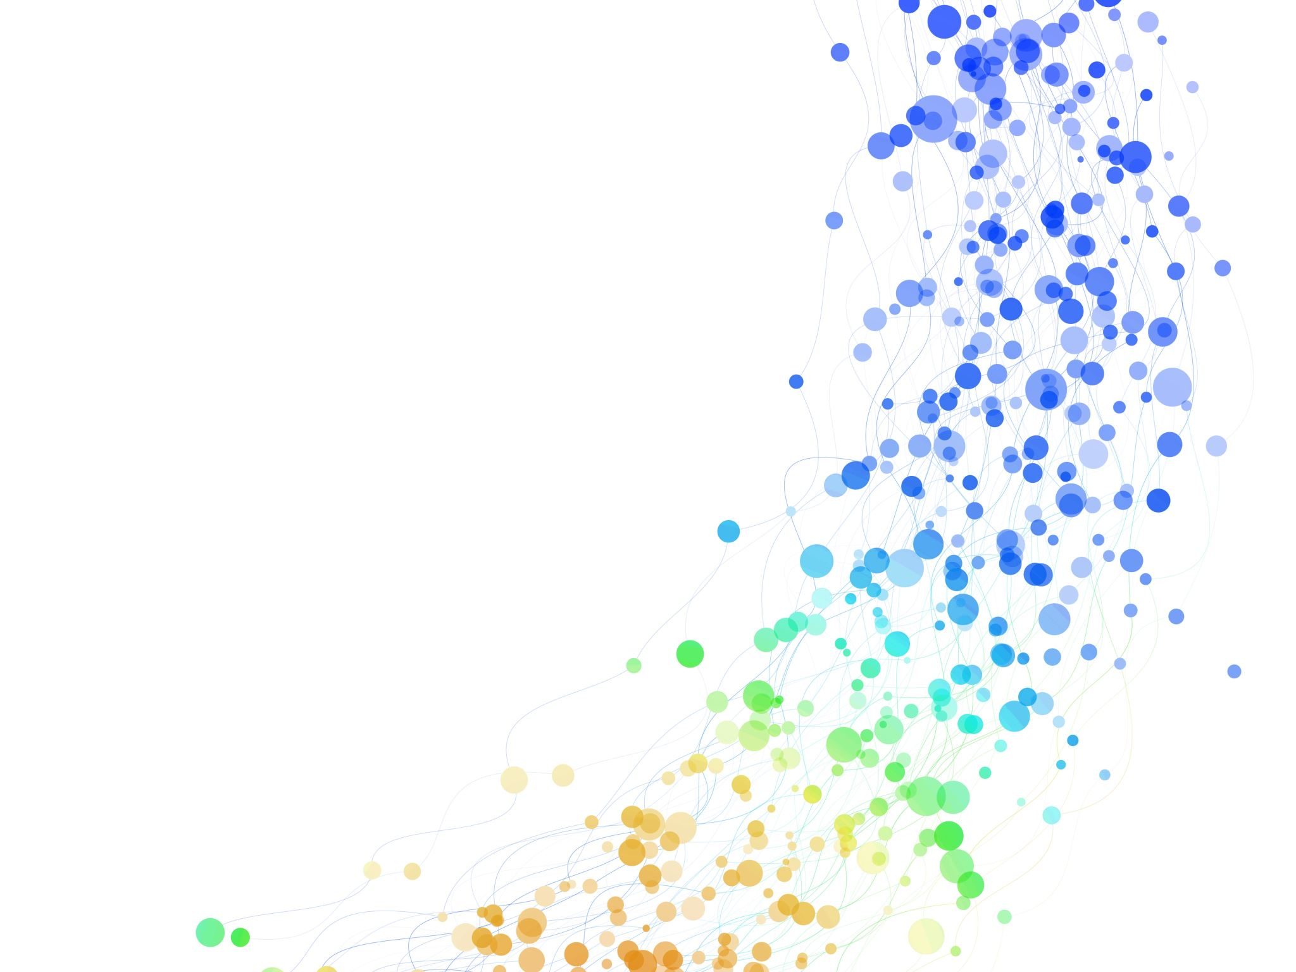
No Other Way to Peace in Korea? A practical path to reunification
Dr Michael Schluter CBE
President and Chief Executive of RPI
RPI Book launch in London
23rd February 2023

Slide 2
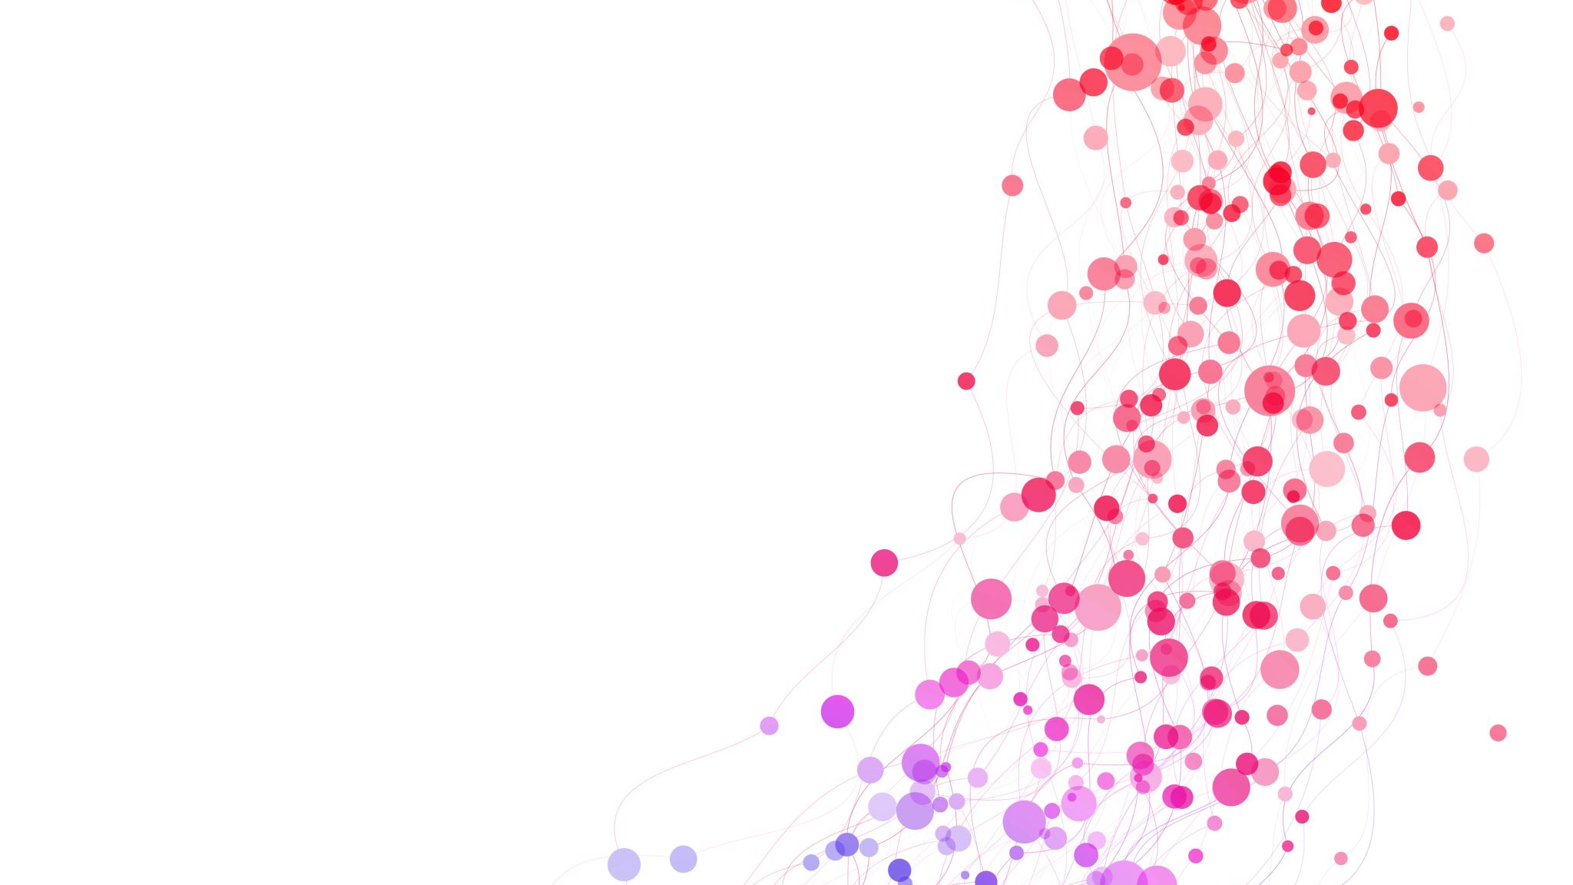
Introducing RPI
Base: Geneva and Cambridge
Track 2: South Africa, Rwanda, Sudan and Ukraine
Special focus: Relational Connectivity

Slide 3
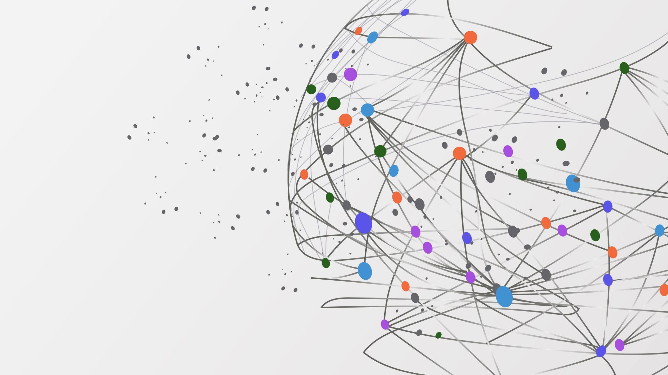
Why Peace in Korea is urgent
Danger of Skirmishes between the two Koreas
Danger of the DMZ becoming the front line of US/China cold war
Continuing suffering of the Korean people

Slide 4
Where to start the peace process?
Focus first on DPRK/ROK relationship
ROK the route to heal DPRK/US relationship
Denuclearisation of DPRK impossible without reunification of the Peninsula

Slide 5
Overview of relationship between two Korea since 1953
1970 talks
1994 talks
2002 Sunshine Policy
2004-2013 Kaesong Industrial Complex
Since 2014, no new major initiative

Slide 6
Reunification on what basis?
DPRK or ROK implode
Capitalism or Socialism
How to get it started

Slide 7
Capitalism vs Socialism
Relational Thinking a genuine third way
Liberté
Égalité
Fraternité
Notes:
Avoids a zero-sum game between DRPK and ROK. the question is ‘is there a viable alternative, or even something better than Capitalism and Socialism?’

Slide 8
Challenges of writing the book
Identifying shared values for all Koreans
Identifying relational norms for each sector
Providing brief overview of sectors in DPRK and ROK
Identifying possible shared policy goals to bring about alignment

Slide 9
Other research issues
Data on Switzerland as case-study of a Confederal/ Federal state (Chapter 15)
Evaluating likely response of US, China, Russia, Japan
Understanding the culture of forgiveness and reconciliation in East Asia

Slide 10
Structure of the book
KPAC: getting it started
Next step: KPEC
Third step: KPSEC
Fourth step: Confederation/Federation
Last step: Korea as a neutral, multi-connected state

Slide 11
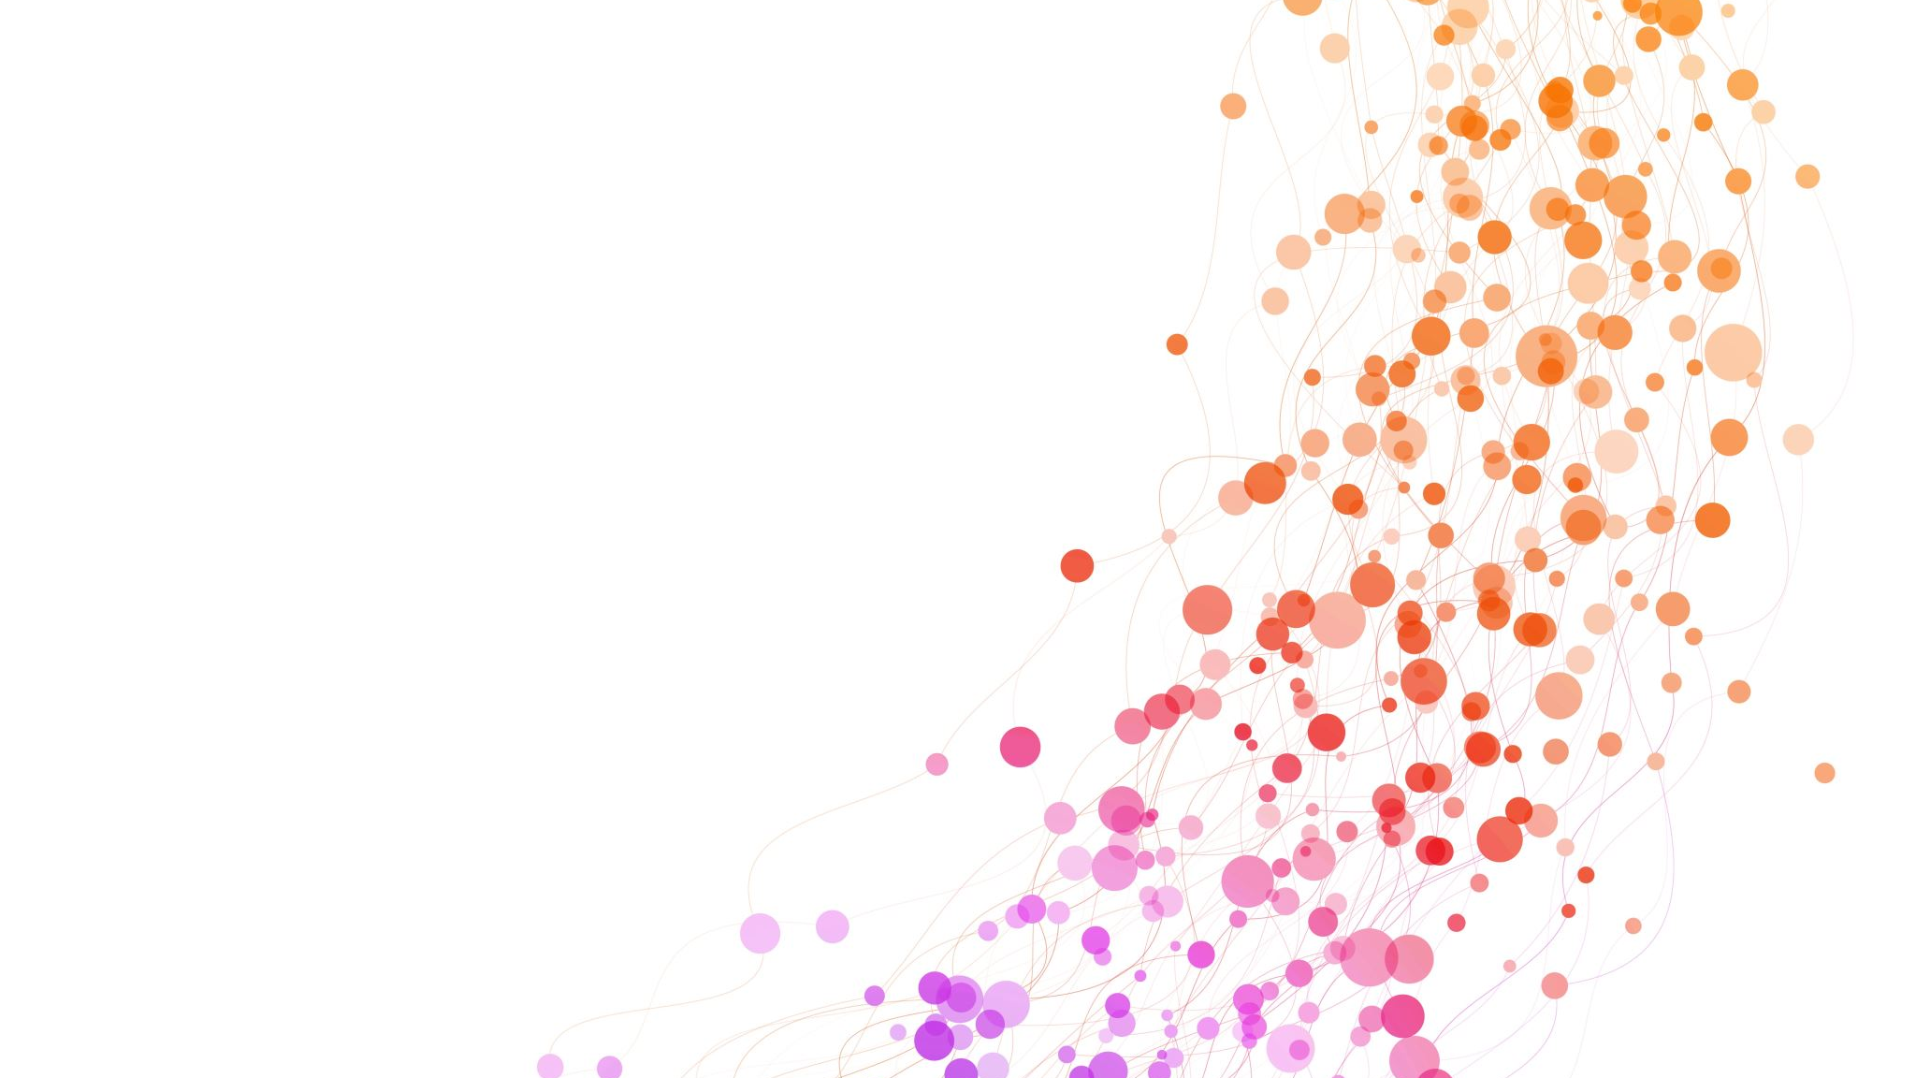
Where next for RPI
Translation of the book into both Korean dialects
First meeting to discuss KPAC
Promote discussion groups (videos and questions) through university, churches etc
Funding through a Korea Peace Bond
Encourage renewed prayer

Slide 12
Comments and questions

